Slide 1

LPL HACKARAMA 2024
“FUTURE OF TECH IN FINANCE"
January 27-28th, 2024
Digital Technology Labs – Confidential

Slide 2

TEAM 10 – <2HACKERS>
01 Kelly Chang
02 Aaron Li

Slide 3

<AUTOMATION, AI/ML>
How can we optimize data aggregation and analysis from different financial news sources?
Notes:
Aggregating and analyzing financial news data from different sources in an optimized workflow process based on sentiment analysis, helping analysts determine decisions ie. buying/selling based on recent news.

Slide 4
SOLUTION DESCRIPTION
Data Acquisition via Web Scraping
Utilized request package to scrape top 30 CNBC article titles for each industry based on different top companies
Sentiment Analysis on Data Acquisition
Developed a Python notebook that processes scraped data through AI/NLP algorithms
Encodes and calculates sentiment scores of news articles from different industries
Website Interface for Data + Sentiment Analysis
Displays data from our data acquisition and sentiment analysis sections
User interface for both steps
Integration of Microsoft Power BI for Visualizations
Uses Power BI’s Rest API to connect data acquisition with Power BI tool
Transforms raw data into powerful visualizations

Slide 5
Benefits + Future Endeavors
Benefits:
Automatic AI/ML Data Analyses
Large quantities of web scraped data can be run on multitudes of different AI/ML algorithms
Universalization of Financial Data Analysis
Integrates financial data with Microsoft Power BI, allows users with less technical background to fully analyze data trends
Future Endeavors:
Fully integrate with Power BI through SQL integration, allowing dynamic data processing
Other data analyses processes besides sentiment analysis, creating detailed AI portfolios of industries
Notes:
Our completed workflow would seamlessly web scrape new news articles daily, updating the sentiment scores and Power BI generated visualizations everyday as well. Our website and PowerBI would be fully integrated and visualizations would be created or updated based on data from previous days/weeks/months/years. The website would be a powerful tool for generating automated insights based on current news.

Slide 6

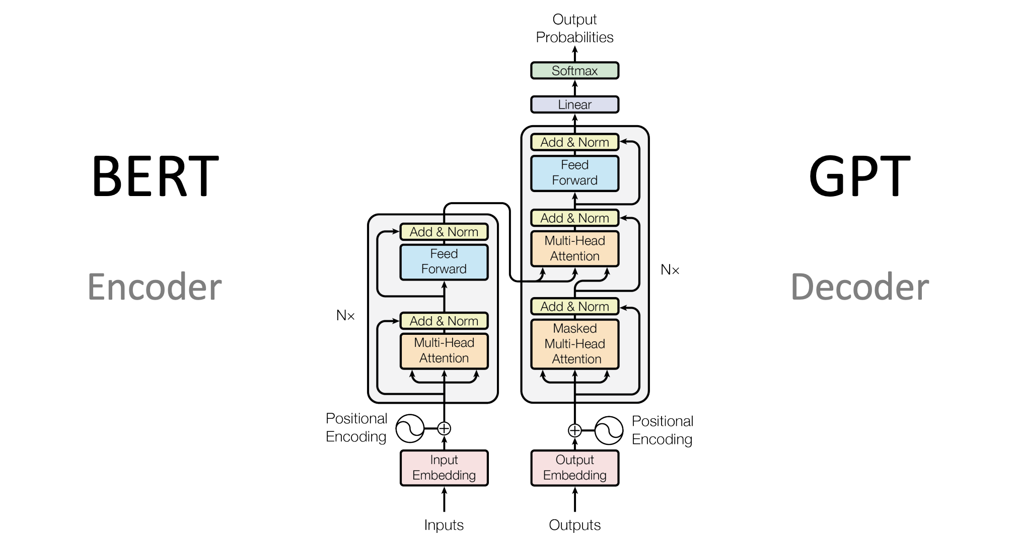

TECH STACK
Web Server/Database:
Frontend: HTML, CSS, Bootstrap
Backend: Node.js, Express, JSON
Web Scraper:
Python
Tools: CNBC API
Queried through our web server
Sentiment Analysis Server:
Python
Libraries: PyTorch, Transformers
Configured BERT model
Queried through our Web Server
Power BI Tool:
Retrieve data through our custom Web API

Slide 7
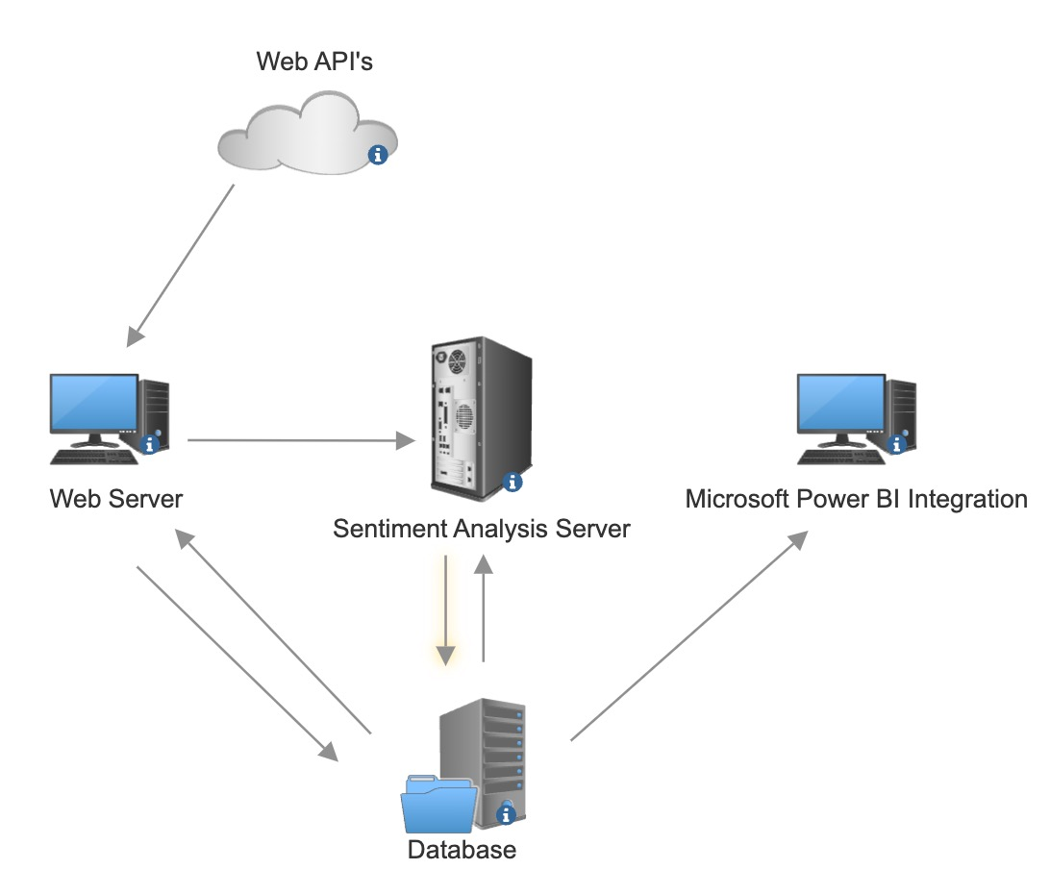
Network Diagrams
Web API’s: Used to web scrape different news sources
Web Server: Hosts our main website, which queries from both our database and sentiment analysis server
Sentiment Analysis Server: Hosts our AI sentiment analysis algorithms, queried by our web server and stored on database
Database: Stores all the data collected from Web API’s and Sentiment Analysis Server
Microsoft Power BI Integration: Integrates with this powerful financial analyst tool

Slide 8
DEMO

Slide 9
Github

Slide 10

THANK YOU!

